Slide 1
Multiple Levels of Abstraction in Algorithmic Problem Solving
David Ginat
CS Group, Sc. Edu. Dept.
Tel-Aviv University
Yoav Blau
El. Eng. Dept.
Tel-Aviv University
SIGCSE 2017

Slide 2
Take a Moment to Consider
Given N numbers, find the max difference between any two numbers
Example:
Input: 3,-5,4,9,2,-1,7,6
Output: 14

Slide 3
Concrete-Level Solution
Given N numbers, find the max difference between any two numbers
Solution:
for i$←$1..N {
for j$←$i..N {
check |n_{i}-n_{j}|
}
}

Slide 4
Concrete-Level Solution
Given N numbers, find the max difference between any two numbers
Solution:
for i$←$1..N {
for j$←$i..N {
check |n_{i}-n_{j}|
}
}
Time: $O\left(N^{2}\right)$
Memory: $O(N)$

Slide 5
Abstract-Level Solution
Given N numbers, find the max difference between any two numbers
Input: 3,-5,4,9,2,-1,7,6
Output: 14

Slide 6
Abstract-Level Solution
Given N numbers, find the max difference between any two numbers
Solution:
for each n {
check if MAX
check if MIN
}
return MAX - MIN

Slide 7

Abstract-Level Solution
Given N numbers, find the max difference between any two numbers
Solution:
for each n {
check if MAX
check if MIN
}
return MAX - MIN
Time: $O\left(N\right)$
Memory: $O(1)$

Slide 8
Concrete vs. Abstract
Concrete:
“max difference between any two numbers”
Abstract:
Assertion – The max difference in a sequence of numbers is the difference between max and min
Considering the whole sequence rather than individual pairs

Slide 9
Abstraction in CS Education
Computational thinking is using abstraction and decomposition… choosing an appropriate representation for a problem or modelling the relevant aspects to make it tractable – J. Wing [2006].
Studies of Abstraction in CS:
O. Hazzan [2002]
J. Perrenet & E. Kaasenbrood [2006]

Slide 10
Interpretations of Abstraction Levels
Abstraction level as the quality of the relationships between the object of thought and the thinking person.
Abstraction level as a reflection of the process-object duality (of first perceiving a term, or a concept by its computation and later by its encapsulation into an object).
Abstraction level as the degree of complexity of the concept of thought.

Slide 11
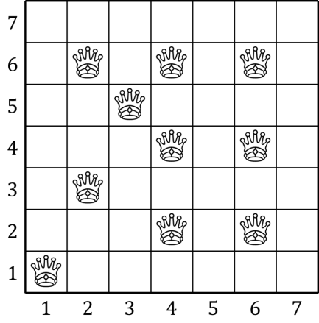
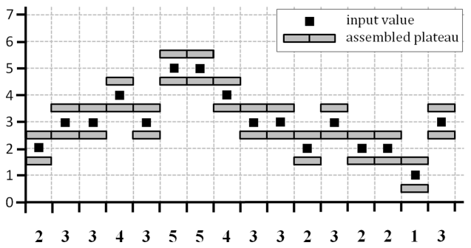
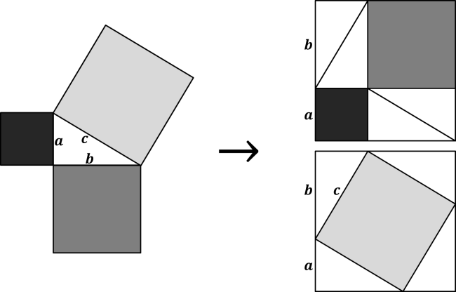
Outline
Queens
Longest Plateau
The Power of Visualization
Experiment & Results
Discussion

Slide 12
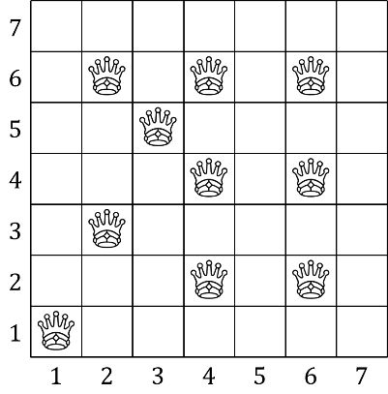
Queens
Given the coordinates of K queens on a NxN chessboard, find the number of threats T
Input:
6,4 2,3
6,2 3,5
1,1 4,4
4,6 6,6
2,6 4,2
Output: 17

Slide 13
Concrete-Level Solution
Solution (focus on queens):
allocate empty board
for each new queen {
check row
check column
check diagonals
place queen
}

Slide 14
Concrete-Level Solution
Solution (focus on queens):
allocate empty board
for each new queen {
check row
check column
check diagonals
place queen
}
Time: $O\left(KN\right)$
Memory: $O(N^{2})$

Slide 15
In-between-Level Solution
Solution (focus on pairs):
gather queens
sort by row
sort by column
sort by diagonals

Slide 16
In-between-Level Solution
Solution (focus on pairs):
gather queens
sort by row
sort by column
sort by diagonals
Time: $O\left(K\log{K}\right)$
Memory: $O(K)$

Slide 17
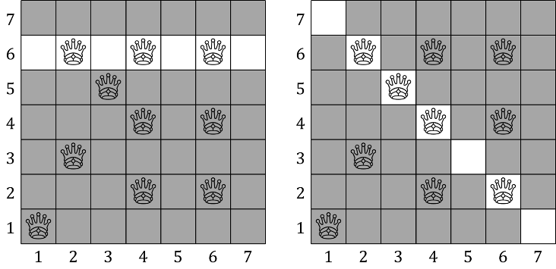

Abstract-Level Solution
Broader-Entity Abstraction
queens $→$ 1D board arrays

Slide 18
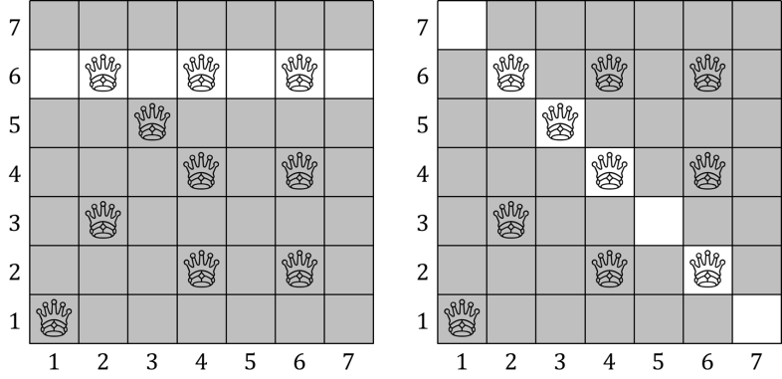
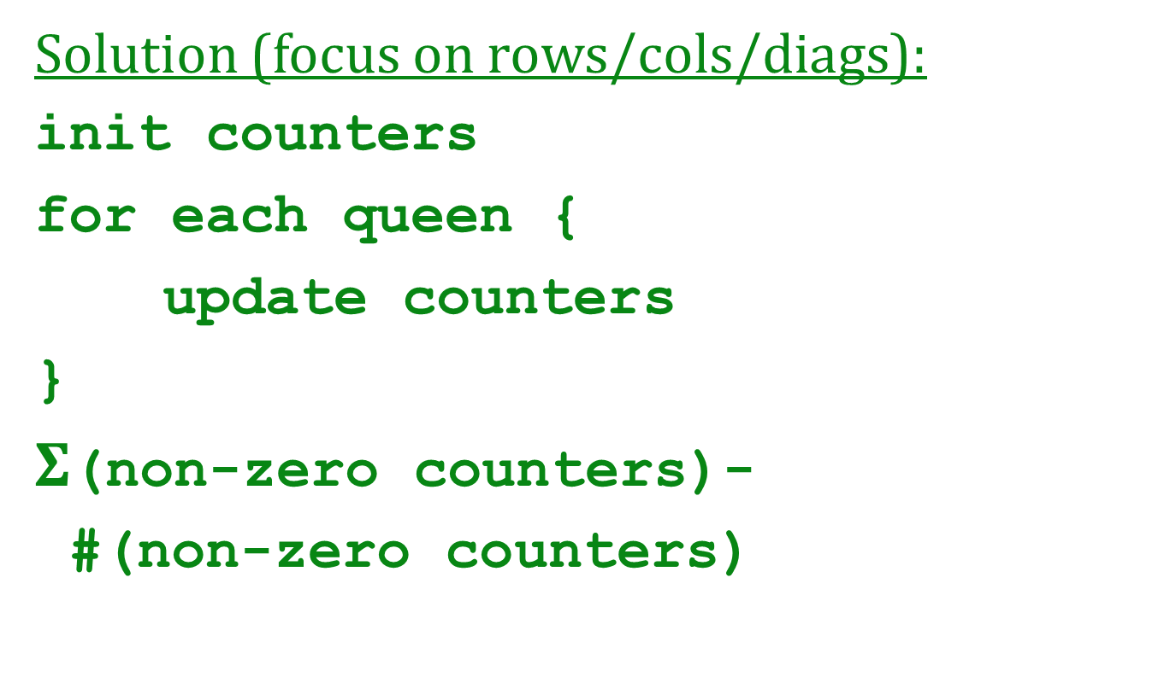
Abstract-Level Solution
Solution (focus on rows/cols/diags):
init counters
for each queen {
update counters
}
$Σ$(non-zero counters)-
#(non-zero counters)

Slide 19

Abstract-Level Solution
Solution (focus on rows/cols/diags):
init counters
for each queen {
update counters
}
$Σ$(non-zero counters)-
#(non-zero counters)
Time: $O\left(K\right)$
Memory: $O(N)$

Slide 20
Concrete vs. Abstract
Concrete:
Focus separately on each queen
In-between:
Focus on pairs of queens
Abstract:
Assertion – The output is the total sum of the number of queens in each row, column, and diagonal, minus the number of rows, columns, and diagonals in which there are queens
Linear view on a 1D board component

Slide 21
Longest Plateau
Given N integers find length of longest plateau
4 3 4 3 3 – plateau
4 3 4 3 2 – not a plateau
Input:
2 3 3 4 3 5 5 4 3 3 2 3 2 2 1 3
Output: 6

Slide 22
Concrete-Level Solution
Given N integers find length of longest plateau
Solution (operational perspective):
for i$←$1..N {
for j$←$i..N {
check [n_{i}..n_{j}]
}
}

Slide 23
Concrete-Level Solution
Given N integers find length of longest plateau
Solution (operational perspective):
for i$←$1..N {
for j$←$i..N {
check [n_{i}..n_{j}]
}
}
Time: $O\left(N^{2}\right)$
Memory: $O(N)$

Slide 24
In-between-Level Solution
Given N integers find length of longest plateau
Overlapping plateaus:
3 2 3 3 3 4 4 3

Slide 25
In-between-Level Solution
Given N integers find length of longest plateau
Overlapping plateaus:
3 2 3 3 3 4 4 3

Slide 26
In-between-Level Solution
Given N integers find length of longest plateau
Overlapping plateaus:
3 2 3 3 3 4 4 3

Slide 27
In-between-Level Solution
Given N integers find length of longest plateau
Solution (latest overlap history):
for i$←$1..N {
switch
case1
case2
...
}

Slide 28
In-between-Level Solution
Given N integers find length of longest plateau
Solution (latest overlap history):
for i$←$1..N {
switch
case1
case2
...
}
Time: $O\left(N\right)$
Memory: $O(1)$

Slide 29
Abstract-Level Solution
As-If Abstraction

Slide 30
Abstract-Level Solution
Given N integers find length of longest plateau
Solution (concurrent plateaus):
for each n {
if same, extend both
if +1, extend top, start new top
if -1, extend low, start new low
if jump, start both
}

Slide 31

Abstract-Level Solution
Given N integers find length of longest plateau
Solution (concurrent plateaus):
for each n {
if same, extend both
if +1, extend top, start new top
if -1, extend low, start new low
if jump, start both
}
Time: $O\left(N\right)$
Memory: $O(1)$

Slide 32
Concrete vs. Abstract
Concrete:
Operational perspective – test plateaus from all possible starting points
In-between:
On the fly, but consider all different cases
Abstract:
Assertion – The longest block-plateau is obtained by extending upper and lower block-plateaus when appropriate

Slide 33
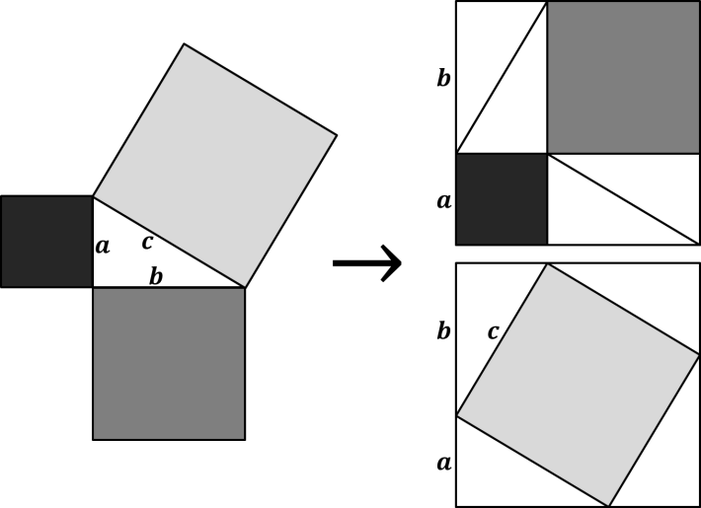
The Power of Visualization
“Seeing” the solution
Convincing
Proof without words

Slide 34
Experiment & Results
56 senior CS students (3 groups)
3 simply stated tasks
3 hours to write algorithmic solution (not code)
Instructed to come up with efficient solution
Basic algorithmic knowledge
Task | Unclear | Concrete | In-between | Abstract
Queens | 7 | 30 | 8 | 11
Longest Plateau | - | 16 | 34 | 6
Max Balanced Sub-list | - | 29 | 10 | 17

Slide 35
Discussion
Summary
Concrete vs. Abstract
Operational vs. Assertional
Take-home message
Focus on task elements and characteristics, not on concrete steps to solution
Running code correctness is not everything
Require declarative statements
Exemplify problem reformulation & visualization

Slide 36
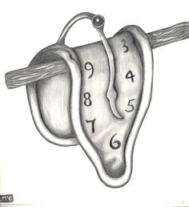
Thank You for Your Time

